Slide 1
NEM Event Leader Reference Guide
Notes:
https://docs.google.com/presentation/d/1tu27eTRBf0j7pjFTcMUaAIHwMbXDPoiSFChGfkdJT-c/edit?usp=sharing
Please start recording so that we can share a video of this presentation!
Please write down your questions and we will have a Q&A at the end!
Rename yourselves, first, last name and name of organization.

Slide 2
INDIGENOUS LAND ACKNOWLEDGMENT
Know where you’re calling from and why it’s important
Express your gratitude for living in this place
Script Template provided
Notes:
Welcome! Thank you for joining us NEM leaders. The land I live on is part of the Crawford purchase, it is the traditional territory of the Mississaugas, Haudenosaunee and Anishinabe. As a treaty person, I am grateful to live here and to support Truth & Reconciliation. My company offers pro bono work to Indigenous led organizations, hires Indigenous team members, and are committed to learning about Indigenous Ways of Knowing and incorporating the notion that we are all relations into everything that we do.
We suggest that you incorporate a land acknowledgement into your event especially if you’re a settler. It is part of our best practices and especially relevant in these times:
To find your territory use this link → Native-Land.ca | Find your territory
The second link is a resource on why and how → Why & how to acknowledge territory
The third link is a government resource → Ontario First Nations Maps

Slide 3
AGENDA & NEM TIMELINE
JANUARY
FEBRUARY
MARCH
APRIL
PLANNING
PROMOTE & PRACTICE
LEAD EVENT
POST EVENT
Attend NEM training session
Finalize event details
Finalize your event team
Create invite list
Promote event (email, Facebook, Twitter, LinkedIn, Instagram, etc.) Samples to be provided.
Practice event with your team
Lead your event!
Join other events. Visit www.nemontario.ca
Get active on social media @nemontario #NEM2022
Engineering Student Challenge submissions due & winners announced
Connect with new contacts

Slide 4
JANUARY
PLANNING YOUR EVENT

Slide 5
1
www.nemontario.ca Tab: Organizer Resources
Panel /Keynote discussion toolkit
Design challenge, Virtual networking event, etc.
Event Resources
2
Confirm your host or moderator
Appoint your technical manager
Roles to Run your Event
3
Determine order of speakers/panelists
Finalize event timing & flow
Finalize Event Details
Notes:
Event resources→ in the next slide we will take a tour of some of event resources available to you!
Roles to run your event→ It is crucial to appoint and confirm your host, co-host, moderator if you have one, and a technical manager for your event.
Finalize your event details→ Working through your event with your team is important to determine the order of speakers and panelists, which will help establish the flow and timing of your event. Practice with your key team members until you get it right!

Slide 6
FINALIZE EVENT DETAILS – Run of Show
<Session Name> ZOOM LINK <To be provide to you> <Date> <Time>
Time | Minute-by-minute | Activity | Description | Facilitators | Materials
11:45- 12:00pm |  | Zoom Set-up |  | Host, Co-host | Presentation Video
12:00- 12:02pm | [2m] | Land Acknowledgement |  | Host
12:02 - 12:07pm | Welcome [2m] Introductions [3m] | Welcome & Introductions | Welcome everyone and introduce panel speakers | Host, Panelists
12:07 - 12:09pm | Housekeeping [2m] | Zoom Etiquette | Microphones on mute, raise hand, use chat, Q+A at end of event | Host
12:09 - 12:51pm | Program [40m] Wrap-up [2m] | Event Programming | (sample) Panel discussion with executive leadership around the importance of lifelong learning for the engineering and technology community. | Moderator/Host - begins programming Tech Manager- monitors chat | Zoom chat
12:51 - 12:54pm | Launch Poll [3m] |  |  | Advise Marianne of any polls you may have
12:54 - 1:00pm | Closing Remarks [4m] Thank you! [2m] | Closing Remarks & Thank you! |  | Host makes closing remarks and thanks panelist and attendees for joining
Notes:
2021 NEM Run of Show Template
Given you may have several people on your team, you might find it useful to ensure everyone is on the same page.
Here is an example of a run of show template that you can use to organize your event minute-by-minute!

Slide 7
FEBRUARY
PROMOTE & PRACTICE

Slide 8
1
Create invite list
Share zoom registration link (to be provided to you)
Promote using email & social media
Promote your event
2
Run of show
Powerpoint presentation
Refine & create materials
3
Level up your Zoom skills
Do a dry run with your team
Practice your event
Notes:
Promote your event→
If you haven’t already started, create your invite list. Who do you want to invite? Use your LinkedIn contacts, share with members. Define your target audience based on the purpose for your event and your definition of success. Draft invitation emails and social media posts.
Zoom Registration→ We will provide you with your unique registration link, distribute this link to anyone you want to invite and we will collect their email address, how they found out about NEM, their consent to be recorded, and some minor demographic information that will help us report to our funders.
All NEM Ontario events are using our NEM Ontario account so that:
We can pre-program questions that we will use to collect data about participants
The waiting room and presenter background will be branded NEM Ontario
We can link directly to your registration link from our website
Social media will be focused on in the slides below where we will take you on a tour of some resources that will help you get ready to promote your event.
Create your materials→ Refine run of show, create a deck (if needed) that you can share with your attendees, and think about your design challenge materials that you will need for a successful event. INSERT IN CHAT→Here is a great tool to take you through the design thinking process for anyone doing a design challenge IDEO’s Design Thinking in a Day workbook
Practice your event→ We don’t mean to be repetitive, but we highly suggest that you do a couple dry runs of your event with your core team. It will make for a seamless and stress-free event!

Slide 9
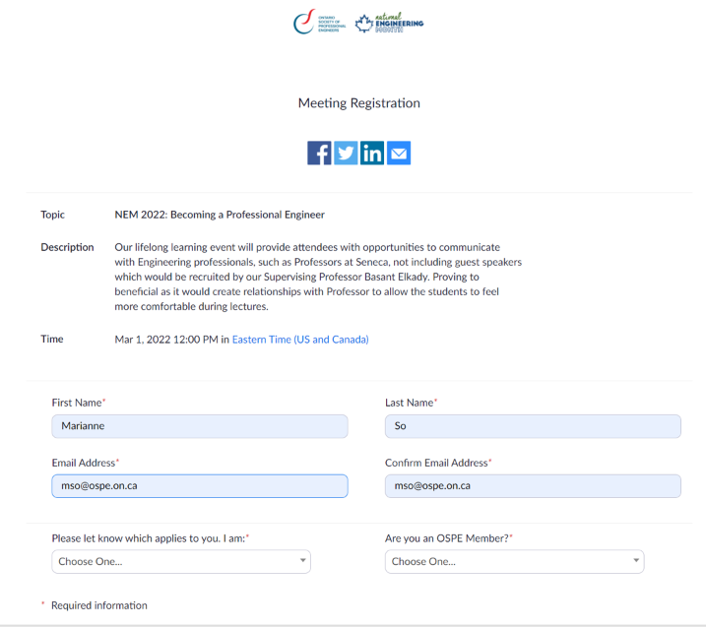
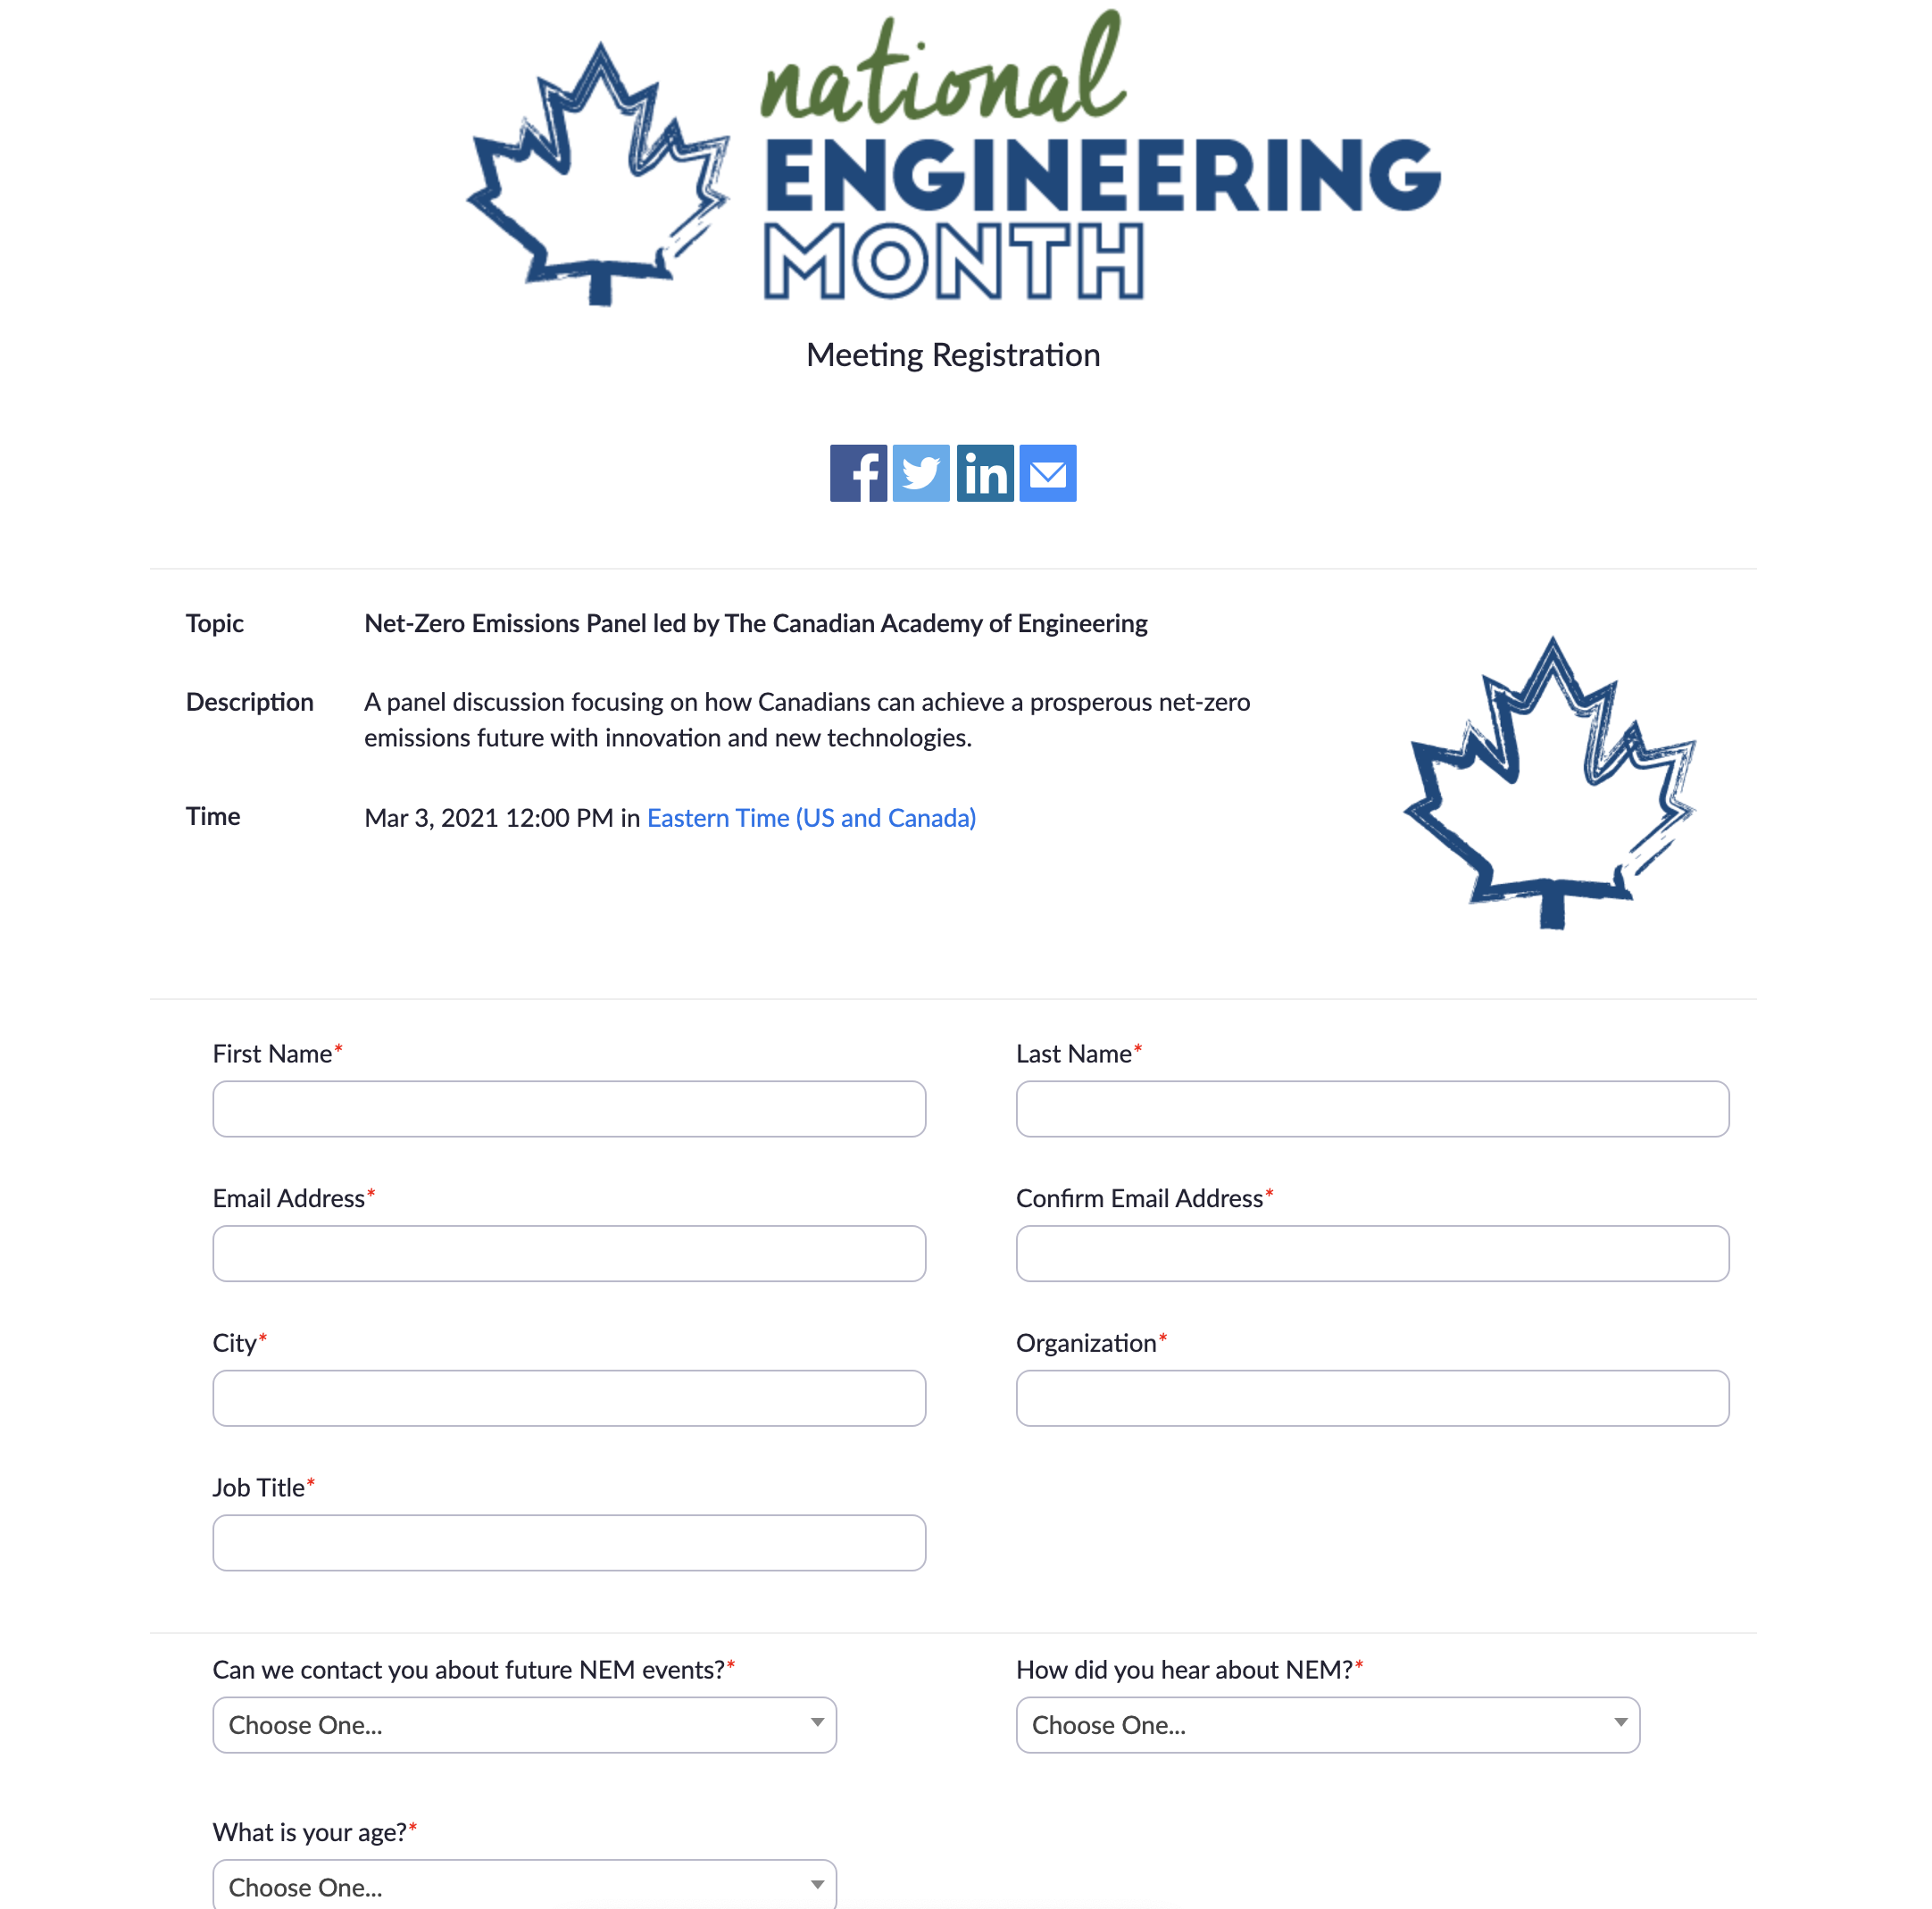
ZOOM LINK
REGISTRATION
Go to the events calendar at nemontario.ca to register for your event
When you invite people to your event there are 3 ways you can ask them to register:
Via the events calendar like you did
Share the unique zoom registration url
Use the social share buttons
Notes:
Note the ATTEND BUTTON → go there and click attend on your own event!

Slide 10
SOCIAL MEDIA
Follow us and we will follow you back
Tag us on social media @nemontario
Use the #NEM2022 hashtag leading up to and during the event
Notes:
BEFORE NEM STARTS → click on the social media logos in this deck and follow us!
→ Tag us on social media @nemontario and we will follow you back!
→ Use the #NEM2021 hashtag leading up to and during the event

Slide 11
LEVEL UP YOUR ZOOM SKILLS
How to use Zoom Like a Pro Video
Notes:
If you have 5 minutes - we suggest you watch this how to use zoom like a pro video.
Here are some important troubleshooting links that will help you level up your Zoom:up your Zoom skills!
How to Mute + Unmute Attendees
How to Stop & Start Video
How to Manage Attendees
How to Share Your Screen
How to Manage Chat Room
All about Polls
→ Knowledge and practice is key with running a seamless Zoom event so practice, practice, practice!

Slide 12
MARCH
LEAD YOUR EVENT!

Slide 13
Event Leader
NEM Ontario background for hosts
Sign in and be assigned as co-host
Admit other team members
Event Recording Starts
Admit all guests
Create breakouts (if needed)
Welcome message & agenda
Land Acknowledgment
Housekeeping
Lead event programming
Manage the chat room
Monitor questions from participants
Launch poll
Thank everyone & close the meeting
15 mins. Prior to Event Start
Event Start Time
Hello! Agenda
&
Land
Event
Wrap-up
Thanks!&
Poll
Enter NEM waiting room
Audience
Audience gains entrance to zoom
Listen
Listen/participate
Use chat to interact
Participate in poll
Notes:
→ A NEM Ontario team member will be there to support you while you test your presentation, make sure the background and recording are working and help you get ready to admit attendees.
Set-up→ The moderator, event host, co-host, panelists & speakers should arrive 15 minutes prior to the event start time to login in advance.
Host + Co-host sign in
Auto-Record of the event starts
Settings for attendees
Waiting Room (Monitor)
Event Start Time
Admit all guests
Create breakout rooms if needed
Land Acknowledgement, Introduction, Agenda
Land acknowledgement
Welcome message, introductions & agenda
Housekeeping
During Event
Lead programming, monitor time
Manage waiting room & chat room
Wrap-up
Launch poll
Thank you to everyone
Closing remarks
→ After the event you need to answer a two question survey and once that is answered you get the second instalment of funding.

Slide 14
APRIL
POST EVENT

Slide 15
ZOOM LINK
POST EVENT TIMELINE
REGISTRATIONS & POLL DATA
ENGINEERING STUDENTS REPORTS
SEND OUT FUNDING
NEM ONTARIO OVERVIEW
The Zoom registrations & Poll collects data for each event (to be provided to you)
Engineering Students Challenge teams submit their reports/reflections on their events – pdf to letstalk@nemontario.ca
Challenge winners will be announced!
Final event funding will be sent out on April 15, 2022
Communication from the NEM team will be shared about the month as a whole
Thank sponsors/ partners
Event leaders will be encouraged to offer thank you’s to those involved in NEM 2022
Notes:
POLL + RSVP logged→ Their poll and RSVP will share the data of the event with us.
Final Funding sent→ We will send out your funding
Communication→ NEM team will share an overview of NEM 2021, possible sizzle reel, YouTube channel info!

Slide 16
Q&A
THANK YOU!

